Slide 1
InteracTeach
Notes:
Welcome to ClimbCode’s exposition. Here we’ll see how was our work this deliverable.

Slide 2

2
Notes:
We’re sure everyone remembers those days at high school in which they had a lot of homework to do, copying the questions and doing them to show them in class. A bit boring and tiring, wasn’t it? And also for the teacher, because he/she also needed to search in the books the exercises he/she wanted us to do.

Slide 3

3
Notes:
Then… What if there was back in those days a way to do both things easier and faster? A way to do those tasks in our computers?

Slide 4



Idea
+
=
InteracTeach
4
Notes:
The answer to this is InteracTeach, our web platform, which acts as a supporting tool for teaching subjects at schools with the help of software.

Slide 5


Idea
Interactive
5
Notes:
How do we grant this support? Simple, by interactive exercises, a better version of the original paper exercises made by independent programmers. Those exercises are bought by schools in order to increase their content catalog they have for supporting their subjects.

Slide 6
Our Path Today
Workgroup
Final Version
Marketing Plan
6
Notes:
This is the path we’re going to follow during the presentation. First we’ll introduceour working group, after that, we’ll talk about our project’s final version and finally we’ll see our marketing plan.

Slide 7
Workgroup
Notes:
So let’s introduce our group members.

Slide 8
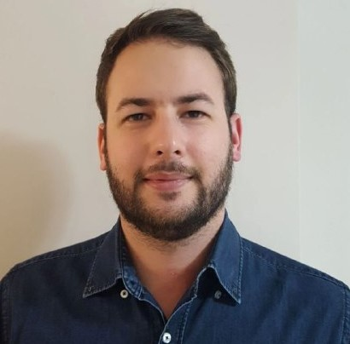

The Workgroup
Alejandro Román Rodríguez
Project Manager
Álvaro Domínguez Núñez Business Manager
8
Notes:
We’re seven people: Alejandro Román, the project manager, Álvaro Domínguez, the business manager…

Slide 9
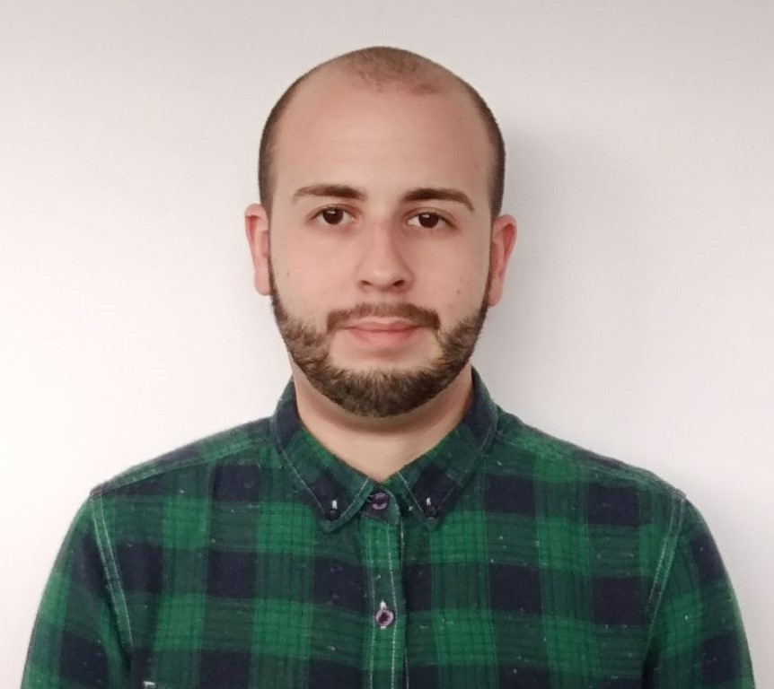
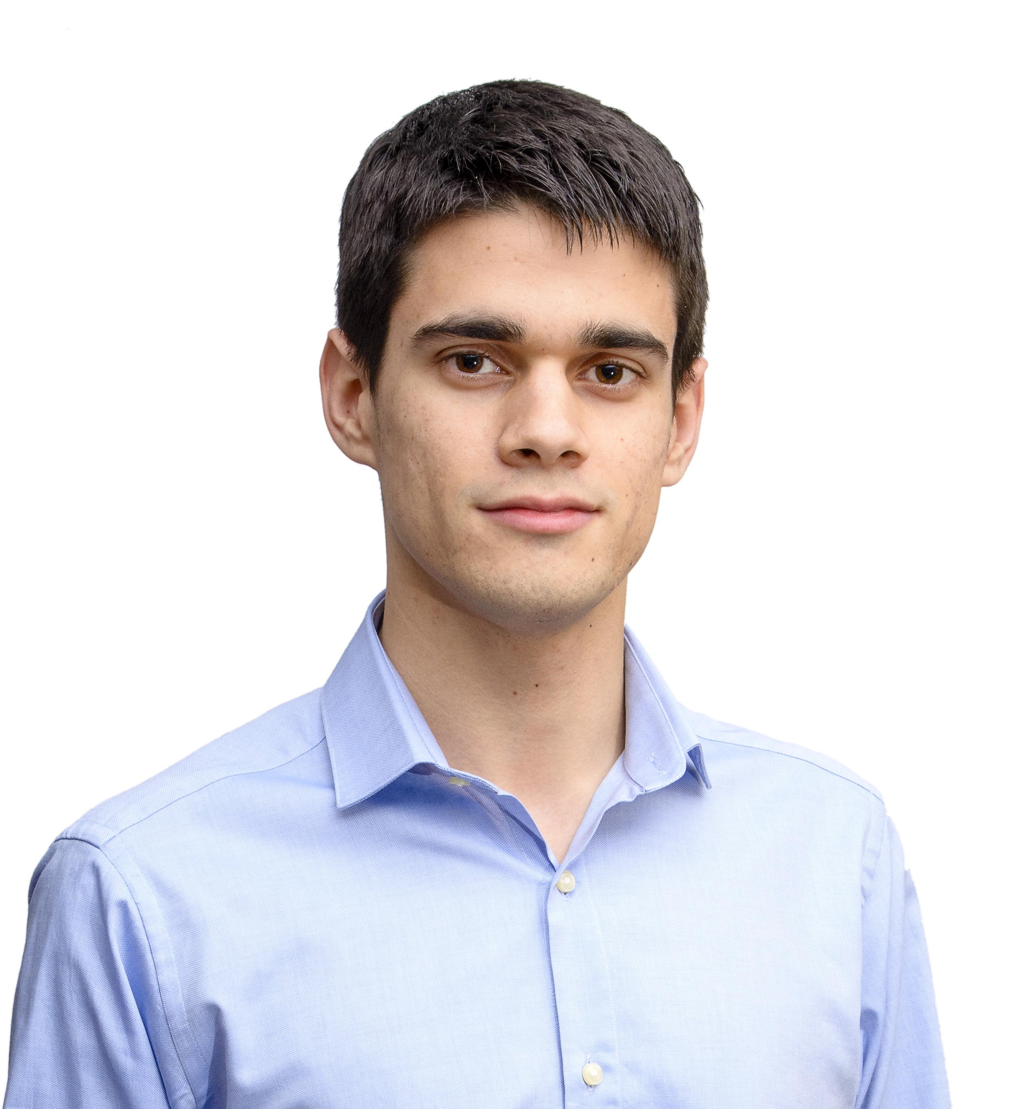
Front-End Developers
Miguel Ángel Baños Carretón Front-End Developer
Alejandro Garrido Resina
Front-End Developer
9
Notes:
Our front-end developers: Miguel Ángel Baños and Alejandro Garrido…

Slide 10
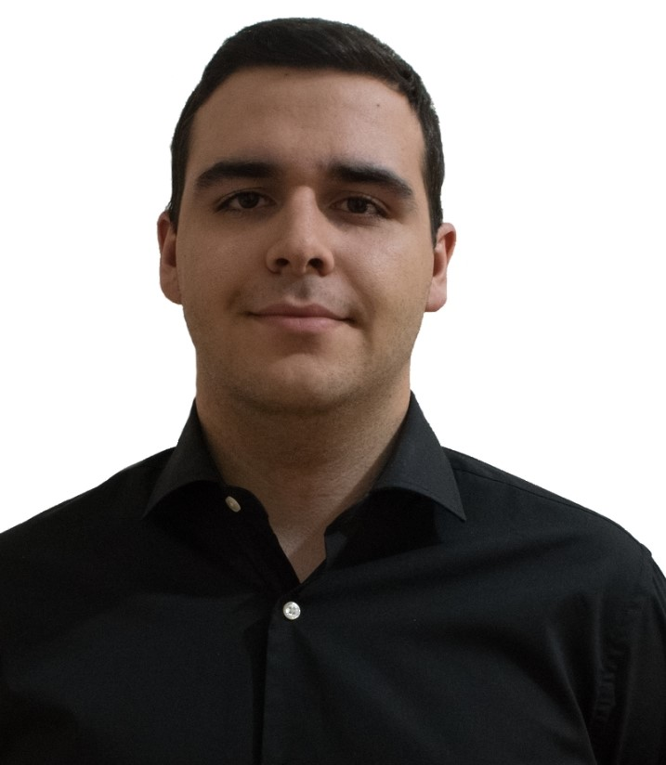
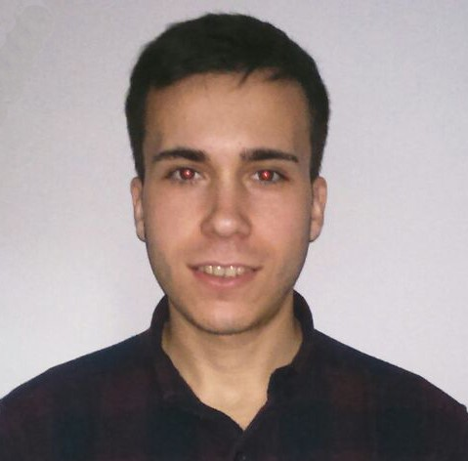
Back-End Developers
Andrés Fernández Alés
Back-End Developer
Álvaro Sánchez López
Back-End Developer
10
Notes:
And our back-end developers: Andrés Fernández, Álvaro Sánchez…

Slide 11
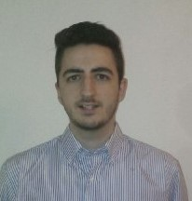
Back-End Developers
Jesús Sosa Sánchez Back-End Developer
11
Notes:
…And Jesús Sosa.

Slide 12
Final Version
Notes:
Now we’ll talk about or project’s final version.

Slide 13



Completed: MVP
Transactions
Interactive
Ordinary Use Cases
13
Notes:
In terms of features that our platform offers, our project’s final version offers all the ones we had as our MVP: Our interactive exercises’ system, allowing it to create and save them on our platform, our transactions’ system, allowing to buy and sell interactive exercises and letting programmers get their money from the purchases of the exercises, and many other minor use cases of our Django model.

Slide 14



Completed: Others
Security
Style
Feedback
14
Notes:
Those features also include solving security problems, the preparation and correction of the style of our platform, and the implementation of all the feedback we’ve got during our pilot plan and that we could include in our project.

Slide 15

Deployment & Demo
Deployment URL: www.climbcode.tk
Demo
15
Notes:
To show how the system works today and how can we get money with it, we’ve put a link in which everyone can see our project, and also we’ve created a demo, showing our two main money sources: Licenses and interactive exercises’ purchase.
Demo: XXXXXXXX
Paypal’s credentials for a school: schoolCC@hotmail.com / climbcodeISPP2018
Admin Account: administrador / climbcode

Slide 16
Marketing Plan
Notes:
Now we’ll talk about our marketing plan.

Slide 17

Marketing Plan: Public
PROGRAMMERS
PRIVATE
SCHOOLS
17
Notes:
Our platform is focused in two main groups of users: The first is independent programmers XXXXXXX.
The other one is private educational centres, XXXXXXX.

Slide 18


Marketing Plan: Social Networks
Facebook: X
Twitter: X
€X
€X
18
Notes:
To reach both groups, we’ve decided to start an advertising campaign divided in different approaches: The first one is advertising ourselves in social networks. In order to do so we’ve spent a total of €X in creating and managing new accounts in Twitter (X) and Facebook (X).

Slide 19
Marketing Plan: Banners
Banners
19
€X
Notes:
Another approach is the creation and placement of advertising banners. The banners we’ve used are these ones, and we’ve spent a total of €X in their creation and placement.

Slide 20

Marketing Plan: Meetings
Marketing Meetings
€X
20
Notes:
The third approach was the realization of marketing meetings with schools, showing them our project and trying to get as many new users as possible. We’ve spent a total of €X in this area.

Slide 21

Marketing Plan: Promo
Promo
21
€X
Notes:
And finally, we’ve created a promo which will be placed in our main website, as an advertise and a way to get more users. We’ve spent on it a total of €X. The video is located in our main page: https://www.interacteach.tk/.

Slide 22

THANKS!
You can find me at
alvdomnun@alum.us.es
22
Notes:
And that’s the end of our presentation! Thank you for watching, and if you have any doubt you can contact me at alvdomnun@alum.us.es.

